Slide 1

Chisholm Trail Volleyball
Parent Meeting 2025

Slide 2
Coaching Staff
Janine Smith– Varsity Head Coach
  jsmith@ems-isd.net
Bill Tippett– Varsity Assistant Coach
  wtippett@ems-isd.net
Andrea Sandefer- Assistant Coach, JV Coach
asandefer@ems-isd.net
Bailey Baughn– Assistant Coach, Freshman Coach
  bbaughn@ems-isd.net

Slide 3
Getting Ready for Season
Tryouts
Scrimmages
Schedule
Practice
Opportunities/Communication
Booster Club

Slide 4
Tryouts/Scrimmages/Pictures
Teams are set for right now but it is fluid. We reserve the right to make changes.
  Friday’s Scrimmages
    ALL INCOMING and RETURNING PLAYERS NEED TO GO TO SCRIMMAGES AND ALL PRACTICES. WE RESERVE THE RIGHT TO MAKE CHANGES ON TEAMS IF NECESSARY.
    FRIDAY SCRIMMAGES ARE AT CLEBURNE. WE WILL LEAVE AT
    6:30AM
  Saturday’s Scrimmages
    SATURDAYS SCRIMMAGES ARE AT KELLER TIMBERCREEK. WE WILL LEAVE AT 7:30AM
    WE WILL NEED PARENTS TO HELP WITH FOOD FOR EACH TEAM FOR SCRIMMAGES. BOOSTER CLUB WILL EXPLAIN

Slide 5
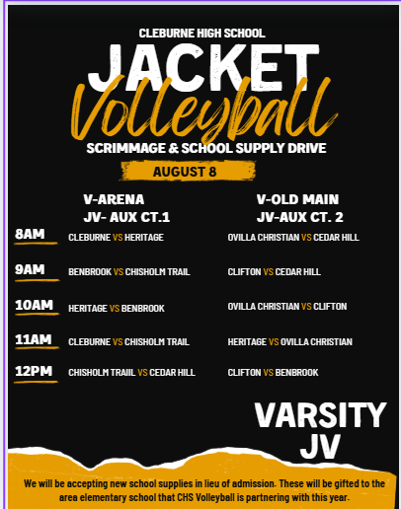


Cleburne Scrimmage

Slide 6
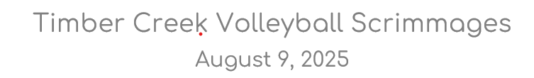
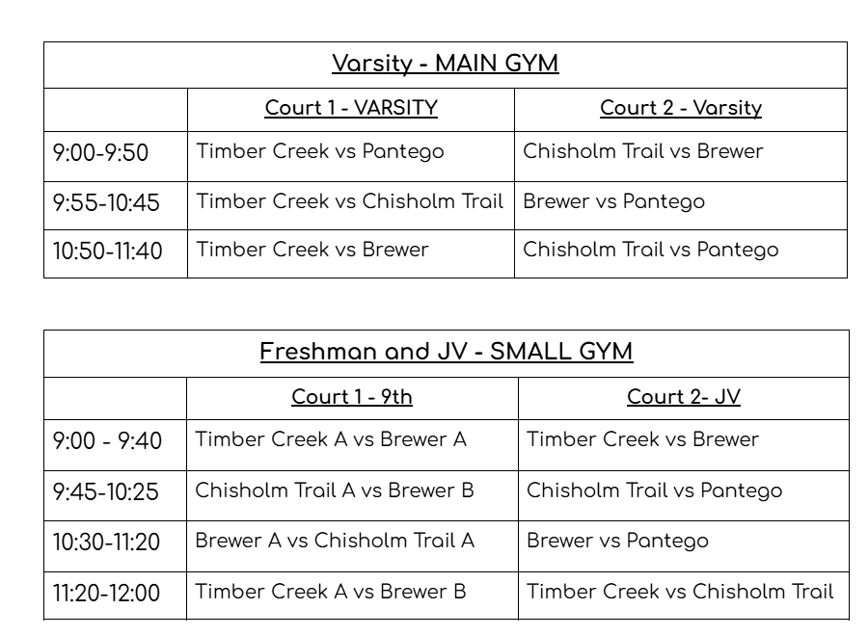
Keller TimberCreek Scrimmage

Slide 7
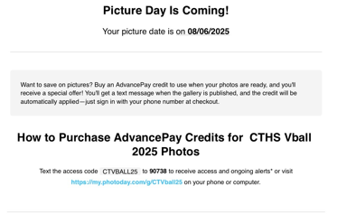
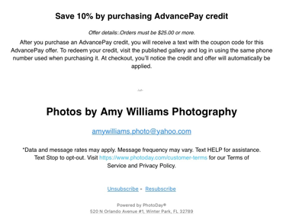
Picture Day
August 6th at 11 am in the Main Gym or Practice Gym
Varsity will start and Sub varsity will follow.
Amy Williams will be our photographer this year.

Slide 8
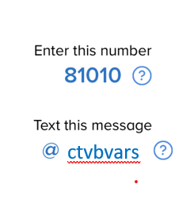
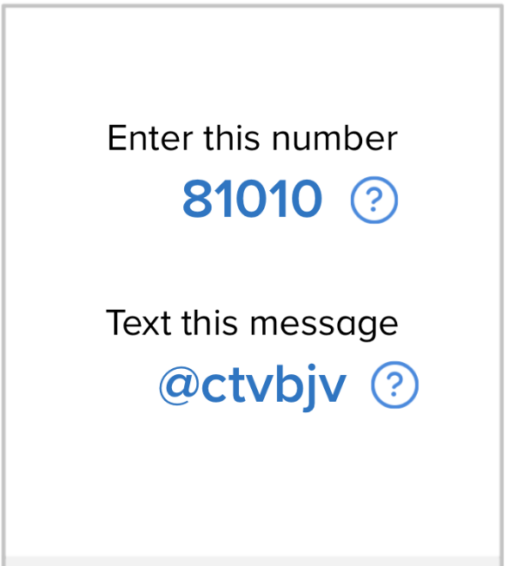
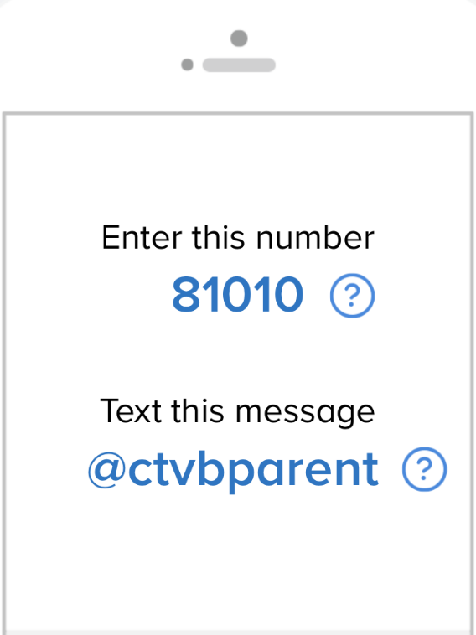
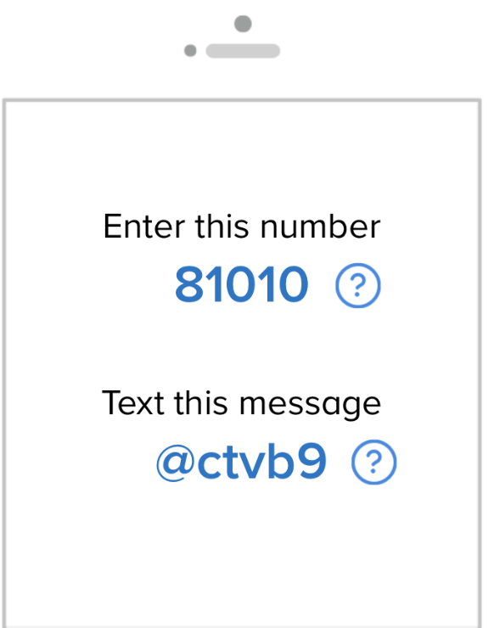
Remind until Parent Square is up and running

Slide 9
Social Media
Instagram: @cths.volleyball
Twitter/X: @cths_volleyball
Athletics Website: chisholmtrailathletics.com
Schedule and Game Updates: Rankonesport.com
Any CTHS volleyball athletes social media should represent CTHS in a positive manner
https://apps.apple.com/my/app/ems-isd-athletics/id1665291101

Slide 10
Schedule
https://www.rankone.com/Schedules/SpeedScheduler.aspx

Slide 11
Chisholm Trail Volleyball Schedule 2025
Month | Day | Opponent | Site | Varsity | JV | 9th | FOOD | Special Event
August
8 | Fri | Cleburne Scrimmage | Cleburne HS | TBA | TBA | TBA | Families
9 | Sat | Keller Timbercreek Scrimmage | Keller Timbercreek | TBA | TBA | TBA | Families
12 | Tues | Mansfield Timberview | **HOME** | 630 | 500 | 530 | Eat before
14-16 | Th-Sat | Denton Classic Tournament | Denton Ryan HS | TBA |  |  | Families
19 | Tues | Boswell | **HOME** | 630 | 500 | 530 | Families
21-23 | Th-Sat | Granbury Tournament | Granbury HS | TBA |  |  | Families
26 | Tues | Paschal | **HOME** | 630 | 500 | 530 | Families | PARENT NIGHT
29-30 | Fri-Sat | Arlington Invitational | Arlington HS | TBA |  |  | ??
September
2 | Tues | Burleson Centennial | Burlington Centennial HS | 630 | 500 | 530 | Coaches
5 | Fri | Northwest | Northwest HS | 630 | 500 | 530 | Coaches
6 | Sat | Kennendale Tournament | Kennedale HS |  | TBA | TBA | Families
9 | Tues | Fossil Ridge | **HOME** | 600 | 500 | 500 | Families | Teacher/Military
12 | Fri | Granbury | Granbury HS | 500 | 500 | 500 | Coaches
13 | Sat | Middle School Madness | CTHS, EMHS, EWMS, MCMS |  | **ALL HANDS ON DECK**
19 | Fri | Brewer | **HOME** | 600 | 500 | 500 | Families | HOMECOMING
23 | Tues | Azle | Azle HS | 600 | 500 | 500 | Coaches
26 | Fri | Saginaw | **HOME** | 600 | 500 | 500 | Families
30 | Tues | Aledo | **HOME** | 600 | 500 | 500 | Families | Middle School
October
3 | Fri | Fossil Ridge | Fossil Ridge HS? | 600 | 500 | 500 | Coaches
7 | Tues | Granbury | **HOME** | 600 | 500 | 500 | Families | PINK OUT
14 | Tues | Brewer | Brewer HS | 600 | 500 | 500 | Coaches
17 | Fri | Azle | **HOME** | 600 | 500 | 500 | Families | Senior Night
21 | Tues | Saginaw | Saginaw HS | 600 | 500 | 500 | Coaches
24 | Fri | Aledo | Aledo HS | 600 | 500 | 500 | Coaches

Slide 12
Practice Schedule
AUGUST 1-2ND TRYOUTS 9-11am AND 1-4pm all levels
AUGUST 4-7th WILL DEPEND ON Teacher Professional Development
VARSITY WILL PRACTICE 7:30-9:30am AND 3-6pm or 4-7pm.
If Professional Development schedule allows us to start at 3 then we will have practice from 3-6pm otherwise practice will be from 4-7pm
JV WILL PRACTICE from 4-7pm Mon-Thurs AND 7:30-9:30am when/if called by coach.
9th WILL PRACTICE Mon-Tues 4-7pm, Wed 3:30-5:30pm
Thurs 7:30-9:30am and 4-7pm
WHEN SCHOOL STARTS
FRESHMEN WILL PRACTICE FROM 7:15-9:30 MON-FRIDAY, SATURDAY PRACTICES WILL BE CALLED AS NEEDED BY COACH
GAME DAYS THE FRESHMEN WILL START AT 8:30.
VARSITY/JV WILL PRACTICE 3:30-6:30 MON-FRIDAY
SATURDAY PRACTICES WILL BE CALLED AS NEEDED BY COACH
…

Slide 13
Student Insurance
How to enroll online
https://www.emsisd.com/cms/lib/TX21000533/Centricity/Domain/61/MMC_Voluntary%20Plan_How%20To%20Enroll%20Online.pdf
Enrollment Form
https://www.emsisd.com/cms/lib/TX21000533/Centricity/Domain/61/Student%20Accident%20Insurance%202021-22.pdf
Here are links to the student accident insurance.

Slide 14
Special Event Nights
    Parent Night Aug. 26th
    Teacher Appreciation Sept. 9th
    And First Responder
    Middle School Madness Sept. 13th
    Homecoming Sept. 19th
    Middle School Night Sept. 30th
    Pink Out Oct. 7th
    Senior Night Oct. 17th

Slide 15
Volleyball Booster Club
VARSITY
GroupMe
JV
FRESHMAN

Slide 16
Volleyball Booster Club
We will need a parent rep for each team to organize meals for scrimmages and home games.
We will provide a sandwich or taco for you daughter on away single matches. We will need parents to help with food for the student-athletes for scrimmages and if your child does not like the sandwich provided.

Slide 17
Booster Club
  Jennifer Gonzales are our volleyball Rep.
  Booster Club Needs Our Participation
  We will need Team Parent Reps, concession stand , and special event volunteers.
  Work Opportunities, Scholarship Fund, Etc.
  The ability to provide nice things for our program would not be possible without the Booster Club!

Slide 18
Partners/Fundraising
Fundraising
  Middle School Madness Tournament September 13th, Concession Stand, T-shirt sales.
  Fan Pledge August 13th A rep from FanPledge came this summer and I thought we would entertain this fundraiser this year.

Slide 19
Cell Phone Policy and ID Policy
Cell phones, smart watches, headphones or earbuds (that cannot be directly plugged into district provided computer) are prohibited on campus. All students who come to school with phones must have the phones turned off and secured in your backpack upon entering the building. If a student does not comply with this State Law, they will receive automatic 10 days of ISS. This means anyone can confiscate a phone that is visible on your person which would result in 10 days of ISS. Each coach may implement a policy to protect the integrity of their programs.
Varsity will turn in phones to coaches in the morning upon arrival to school and the coaches will lock them up in the safe in Coach Smith’s office until 4:20 or the end of practice. It is recommended that parents email their student if information is to be communicated with your child during the school day. Teachers are going to give students opportunities to check emails throughout the day.
Since sub varsity coaches are not on campus they will abide by State and campus policy stated above.

